Slide 1

Network Design, Monitoring and Security
Red / Blue Team Game
Christian Liu – B00415613
Present for course CSCI 6706
Professor: DR. NUR ZINCIR-HEYWOOD
TA: Duc Le

Slide 2
Agenda
Introduction
Red Team Strategies
Web Services Vulnerabilities
Blue Team Strategies
Results and Comparison
(Tentative Content)

Slide 3
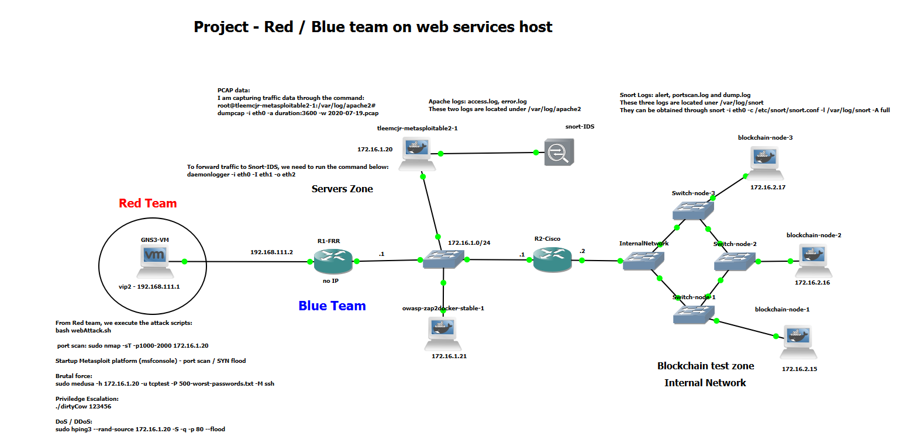
Introduction – Blue / Red Team Game
Red team
Blue team – dream city
Internal Network Users
Web Services Host
Snort IDS
Considerations:
Performance
Monitoring
Security
Screenshot From GNS3 topology: Chris Liu, Inspired by Lab 6, 7

Slide 4
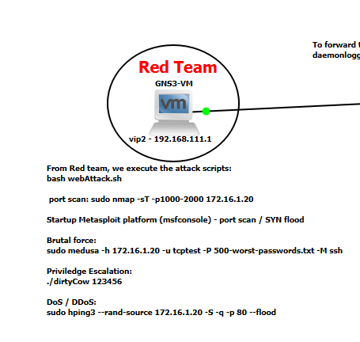
Red Team Pen Test
The planned attacks should be issued in a sequence below
Nmap | Metaploit Framework (Port Scan)
Brute-Force | Medusa, Hydra and Patator
Privilege Escalation | Dirty Cow
Web Vulnerability | ZAP or manually test
ICMP / SYN Flood | Hping3
Screenshot from GNS3 topology

Slide 5
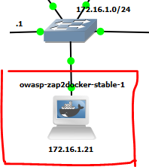
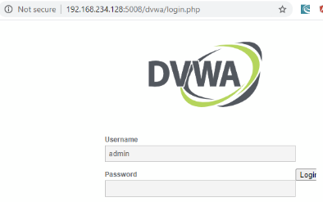
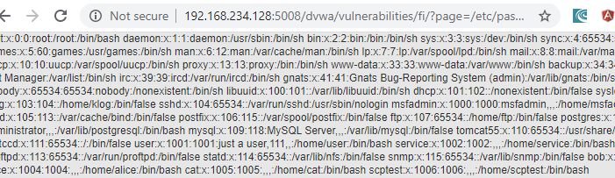
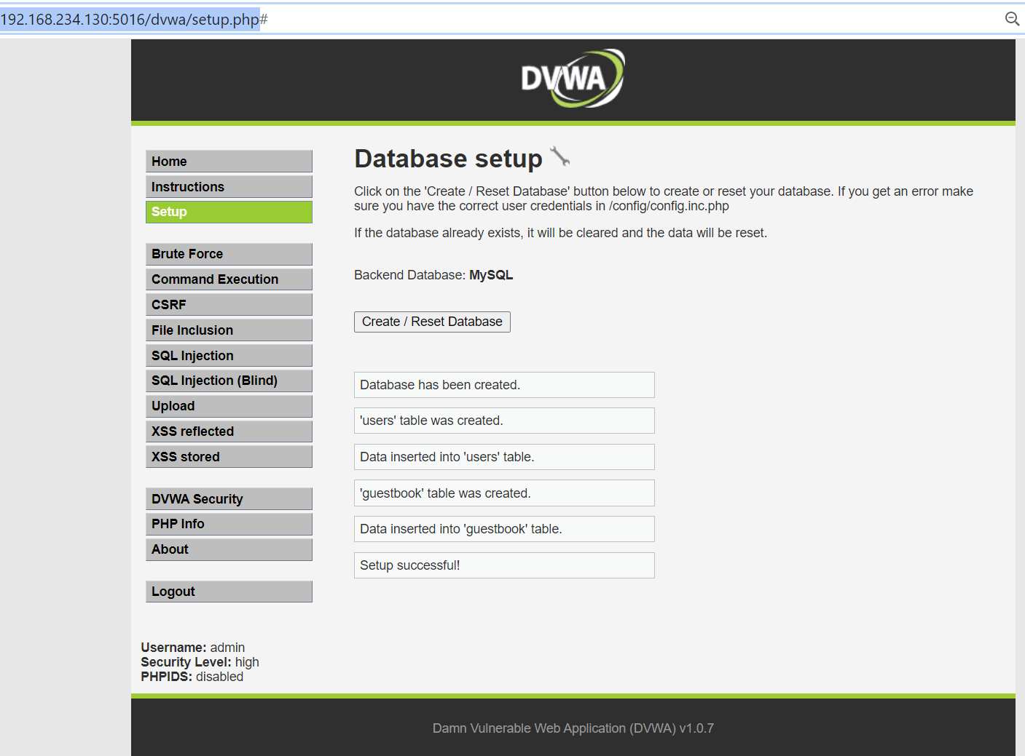
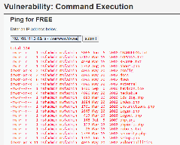
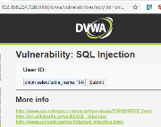
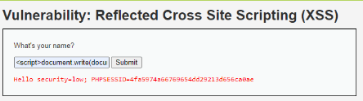
Vulnerable Web Services
Web UI | Vulnerabilities
http://172.16.1.20/dvwa/login.php | Brutal force: this page can be submitted through POST and GET method. And it does not have sophisticated security protection. For example: gns3@gns3vm:~/project$ sudo patator http_fuzz url=http://172.16.1.20/dvwa/login.php method=POST body="username=FILE0&password=FILE1&Login=Login" 0=1000-username-list.txt 1=500-worst-passwords.txt -x ignore:fgrep="Location: login.php"
http://172.16.1.20/dvwa/vulnerabilities/exec/# | Command execution: it allows malicious users to chain another command in the input box via “&&” or “||”. The typical attack can be “127.0.0.1 || ls -l /etc/passwd” Then, we can simulate this action from command line: root@gns3vm:~# curl -d "ip=127.0.0.1+%7C%7C+ls+-l+%2Fvar%2Fwww%2Fdvwa%2F" -d "submit=submit" -X POST http://172.16.1.20/dvwa/vulnerabilities/exec/#
http://172.16.1.20/dvwa/vulnerabilities/fi/?page=file Name | File Inclusion: The malicious users can easily input server file absolute path in the box to view confident information on the server. For example: http://172.16.1.20/dvwa/vulnerabilities/fi/?page=../../../../etc/passwd
http://172.16.1.20/dvwa/vulnerabilities/sqli/?id=userid | SQL Injection: the malicious user can input other SQL code in the box, instead of user id which is supposedly asked for. For example: ‘ union select table_name, ‘TABLESs’ from information_schema.columns where table_schema = ‘dvwa’
The screenshot above shows we can hack the SESSIONID from cookie. | XSS attack: it supposed to ask for username submission. However, malicious user can view the cookie information by input “<script>document.write(document.cookie):</script> in the textbox.
ZAP testing on DVWA web application

Slide 6
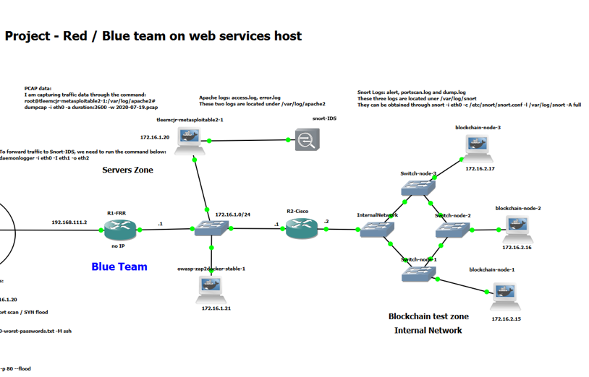
Blue Team Defend Strategy
WireShark Monitoring (between Snort and Metasploitable)
UFW (only allow 22,23,80,443 and limit TCP connection per source IP on R1-RFF)
ACL (on R2-Cisco)
Snort (DROP|REJECT instead of ALERT)
Whitelist | Blocklist (used for blockchain too)
(Tentatively) Blockchain DDoS Defense
Screenshot from GNS3 topology

Slide 7
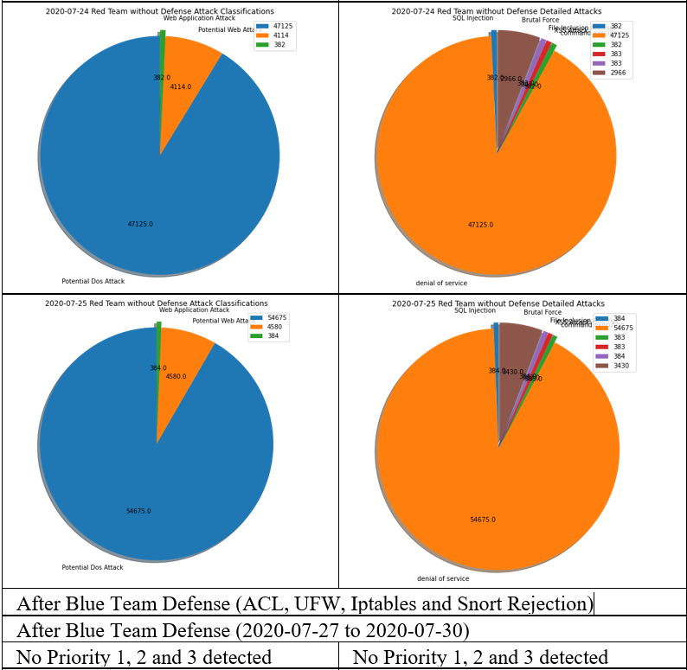
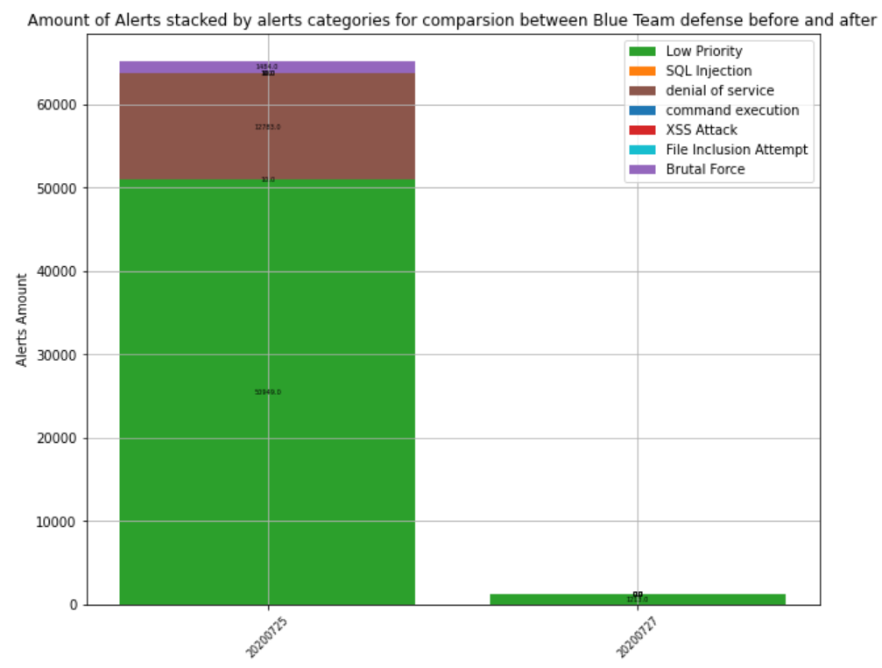
Comparison Before and After
Before Security (July 20th – 24th ) | After Security (July 27th – 31st )
On the consecutive 5 days starting on July 20th , I will monitor the network for one hour with crontab simulation services consumption. During the monitoring, I mainly play red team to attack blue team (web services). After one-hour monitoring is done, I collect data through wireshark or tcpdump, convert data to the most suitable PCAP Datasets via Argus. Eventually, this dataset will be used to compared with the dataset after blue team security enabled. | On the consecutive 5 days starting on July 27th , I will monitor the network with Blue team security guards. After one-hour monitoring is done, I collect data through wireshark or tcpdump, convert data to the most suitable PCAP Datasets via Argus. Eventually, this dataset will be used to compared with the dataset before blue team security enabled.
Screenshot of Python Detection

Slide 8
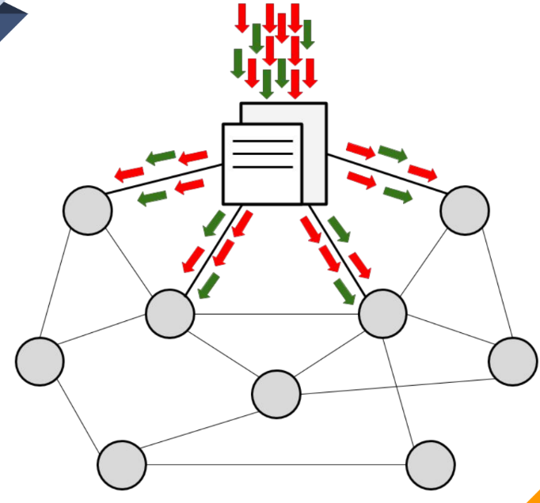
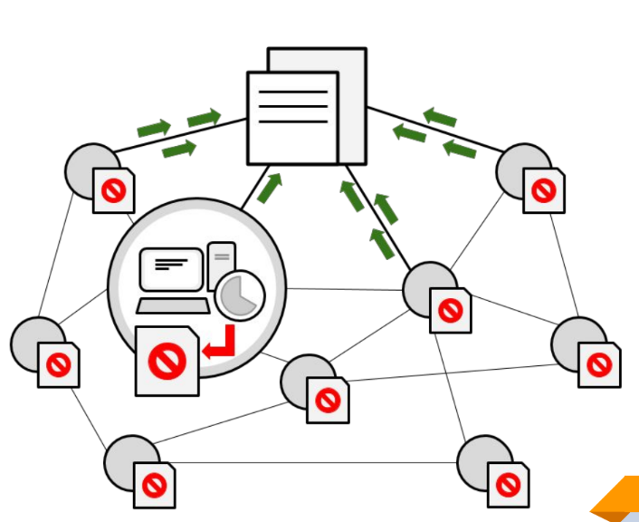
Tentative work on project – Blockchain mitigation (This slide is only additional)
I was inspired by the paper above, which illustrated the process to mitigate DDoS using Blockchain. Combined my project topology, in summary we can do following to mitigate DDoS through Blockchain:
Step 1: identify DoS attack on Blockchain internal network (172.16.2*/24).
Step 2: any attacked nodes distribute traffic to all Blockchain nodes.
Step 3: Nodes call the contract deployed on Blockchain to update blocklist.
Step 4: Using Iptables, drop the traffic from IP in blocklist temporarily.
Credit to “Blockchain Mitigation”, Arpit Bahety etc.
https://drive.google.com/file/d/1z7MSFlwX-DLBUzCc-cJa3edAkwlvHaG0/view

Slide 9
Works Cited
DR. NUR ZINCIR-HEYWOOD, https://web.cs.dal.ca/~zincir/cs6706.html
Duc Le, Lab 6, 7, Brightspace: https://dal.brightspace.com/d2l/home/124069
https://linuxize.com/post/how-to-install-node-js-on-ubuntu-18.04/
Install truffle suite: https://medium.com/@techgeek628/how-to-install-and-execute-truffle-on-an-ubuntu-16-04-7ebb3444707e
Curl web services : https://www.baeldung.com/curl-rest
Medusa guidelines: hackingarticles.in/comprehensive-guide-on-medusa-a-brute-forcing-tool/
Truffle and Ganache-cli: https://medium.com/coinmonks/5-minute-guide-to-deploying-smart-contracts-with-truffle-and-ropsten-b3e30d5ee1e
Snort default alerts: https://www.apt-browse.org/browse/debian/wheezy/main/all/snort-rules-default
Metasplotable commands list: http://atic-tw.blogspot.com/p/userpass.html
https://metasploit.help.rapid7.com/docs/metasploitable-2-exploitability-guide
ZAP guild: https://www.zaproxy.org/docs/docker/about/
Christian Gang Liu: Assignment 2: https://github.com/chrisliu01/network-management/blob/master/assignment%202%20-%20Christian%20Gang%20Liu%20-%20B00415613.pdf
Christian Gang Liu: assignment 3: https://github.com/chrisliu01/network-management/blob/master/assignment%203%20-%20Christian%20Gang%20Liu%20-%20B00415613.pdf
ZAP Concepts: https://en.wikipedia.org/wiki/OWASP_ZAP
Dirty_cow source code : https://www.exploit-db.com/exploits/40839
Privilege Esclastion: https://payatu.com/guide-linux-privilege-escalation
Blockchain based DDoS attack mitigation: https://doi.org/10.1109/IBCAST.2019.8667147
DVWA snort rules: http://m-dabour.blogspot.com/2012/05/using-snort-idsips-for-web-applications.html
Dirty Cow: https://dirtycow.ninja/
Python Analyze of project: https://github.com/chrisliu01/network-management/blob/master/course-project.ipynb
“Blockchain Mitigation”, https://pdfs.semanticscholar.org/9029/0e507959942cf5a3c281dea24bddf2babcb5.pdf

Slide 10


